Slide 1
Budget Modifications
Extramural Grants Administration – Wadsworth Center

Slide 2
Budget modification requests overview
Requests are used to move funds between budget lines within a contract year.
Due 30 days before the end of the budget period being modified
Form must be submitted in Excel format
DOH approval is required for all requests
Office of the State Comptroller (OSC) approval may also be required
Changes cannot jeopardize ability to complete research aims within a contract term

Slide 3
Budget modification requests overview
Budget Modification Period
Due 30 Days Before!
Start of
Budget Period
End of
Budget Period

Slide 4
Budget modification request overview
Cover Page
The Cover Page Tab must be filled out in its entirety following the instructions on Slide 5 of this presentation.
Worksheet & Justification
The Worksheet & Justification Tab must be filled out in its entirety following the instructions on Slides 6-9 of this presentation.
PS Detail
The PS Detail Tab must be filled out in its entirety following the instructions on Slide 10 of this presentation.

Slide 5
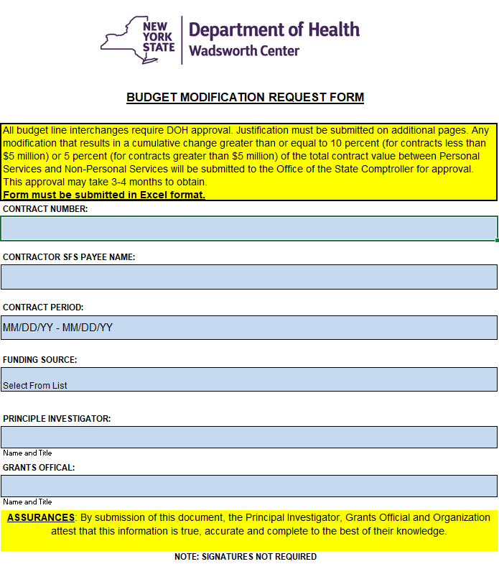
Budget Modification Request – Cover Page
Enter Contract Number (CXXXXXGG or GM)
Enter Contractor SFS Payee Name
Enter Contract Period enter in MM/DD/YY format
Select Funding Source (drop down list)
Enter Name of PI
Enter Name of Grants Official
A signature is not required on this form
1
2
3
4
5
6
7

Slide 6
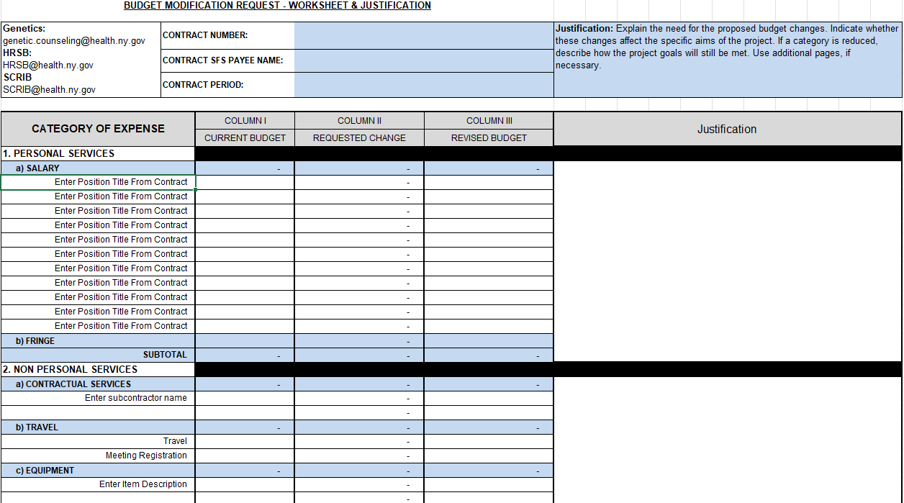
Budget modification request worksheet & justification
1
2
3
4
5
1. Header will populate from Cover Page.
2. Enter budget line details based on the Names/Titles, etc. from the executed contract. Enter Current Budget in Column I,
it must match most recently approved Attachment B-1 or B-1(A).
3. Column II “Requested Change” is formula driven. DO NOT enter data in this column.
4. Enter Revised Budget in Column III.
5. See Tab 8 for additional information on entering your Budget Modification justification.

Slide 7
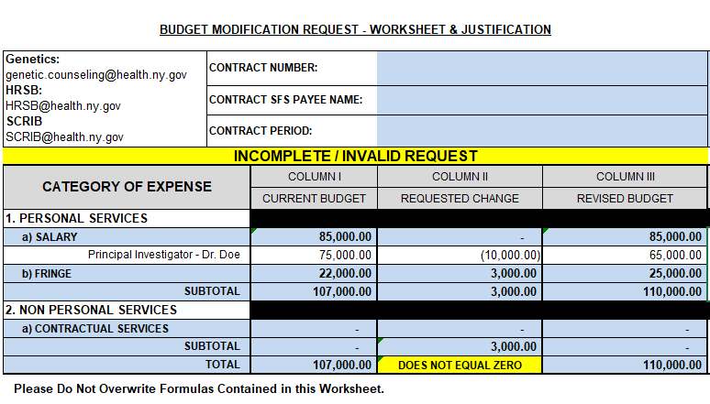
Budget modification request worksheet & justification
Proposed Budget total Must Equal Approved Budget Total and Sum to $0.00!!

Slide 8
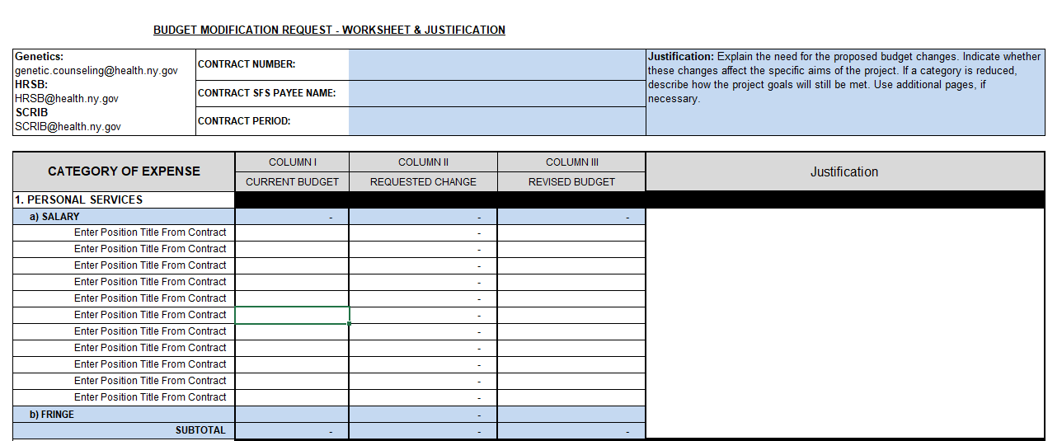
Budget modification worksheet & justification
The revised Budget Modification form allows for the justification to be entered on the same page as the requested budget changes. To ensure your request is reviewed timely and to help alleviate additional questions, each budget line with a requested change amount must be justified in detail.
Detailed Justification Must:
  Explain the proposed change(s)
  Indicate whether change(s) affect(s) approved research aims
  Describe how project goals will be met

Slide 9
Budget modification worksheet & justification
Be Specific
Strength of justification is critical to the approval of the request
Justification must be tied to progress made on contracted research Aims
  Progress to date on each specific aim
  Plans for use of funds to accomplish stated aims

Slide 10
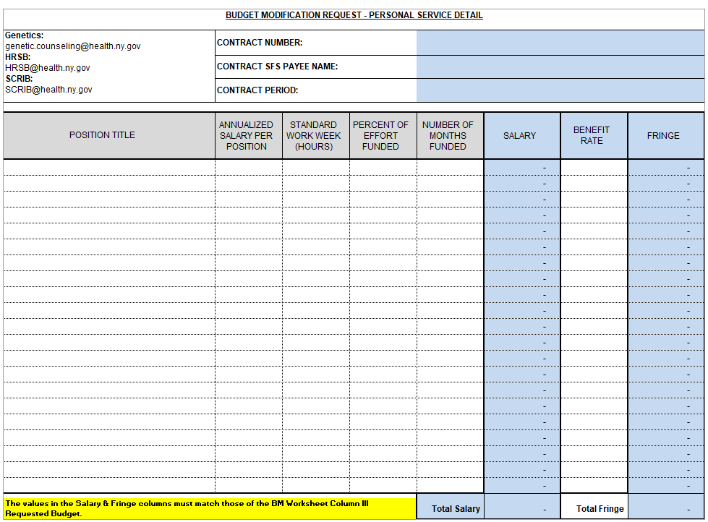
Budget modification Personal Service Detail
1
Header will populate form Cover Page
Position Title must match that of the Worksheet
Salary will automatically calculate based on the information entered in (Annualized Salary, Percent Effort and Number of Months Funded).
Enter Benefit Rate (%) – Fringe will automatically calculate
2
3
4
The Salary & Fringe Column must match the Column III Requested in the CF Worksheet Tab.

Slide 11
Budget Modifications and OSC Approval
Changes less than 10% of the total contract budget require DOH approval
Changes greater than 10% of the total contract budget require OSC approval
10% is cumulative over the contract term
Please limit requests to one modification per budget year. Excessive requests will not be approved.
Fewer modifications = fewer delays in the approval process

Slide 12
Approval Notification
Less than 10% of the total contract budget:
  EGA approval letter
More than 10% of the total contract budget:
  EGA approval letter with contingencies

Slide 13
Any Questions?
Contact us at: hrsb@health.ny.gov scrib@health.ny.gov genetics@health.ny.gov or
(518) 474-7002

